Slide 1





PROGRAMME FOR
DUAL VOCATIONAL TRAINING
Public Employment Service of Catalonia

Slide 2




CONTEXT
Spain ranks last in the EU in terms of youth with neither high school degrees nor VT. 27% do not continue their studies after age 16. Generally occurs in youth with economic urgency.
The highest unemployment rate is seen in the most vulnerable groups, young adults
and others at risk of exclusion.
Some productive sectors are having difficulty finding qualified individuals. Not only in industrial sectors, also in services.
DualVT response to this dual need: qualification for
profiles needed in the LM and hiring of vulnerable
groups to undergo training.

Slide 3




DUAL
OPPORTUNITY
Promotes groups with particular socioeconomic needs to undergo training processes in the medium and long term to overcome job insecurity.
Also simultaneously involves job-creating business sectors in the qualification process of future employees.

Slide 4

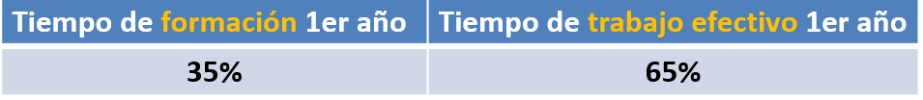



WORK-LINKED TRAINING CONTRACT
Mixed contract type that combines paid work at a company and training activity under the framework of an Employee Training System.
Wage may not be less than the proportional portion of the GMW for work performed.
Students are covered by unemployment benefits if their contracts are not renewed.
Notes:
Training time year 1
35%
Effective working time year 1
65%

Slide 5


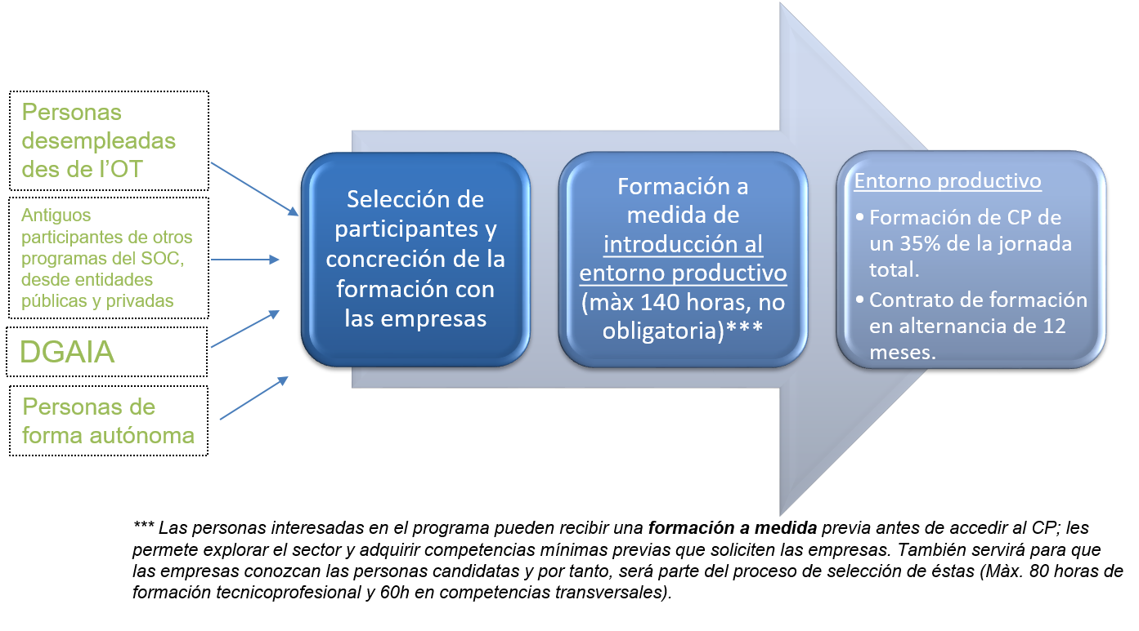

WHAT DOES THIS LOOK LIKE?
Notes:
Unemployed individuals from employment office
Former participants in other programmes from the Public Employment Service of Catalonia provided by both public and private organisations
Directorate General for Child and Adolescent Care
Self-employed individuals
Participant selection and finalisation of training with companies.
Custom training introduction to the productive environment (max. 140 hours, not compulsory)***
Productive environment
Workplace training during 35% of the total workday.
12-month work-linked training contract.
***Individuals who wish to participate in the programme can receive prior custom training before visiting the workplace; this allows them to explore the sector and acquire a minimum level of skills that companies require. This will also allow companies to get to know candidates and, therefore, will be part of their selection process (Max. 80 hours of technical/professional training and 60 hours in transversal skills).

Slide 6




TARGET AUDIENCE
AGED 16–29
Youth aged 16–29 with greater difficulty accessing the labour market, preferably without professional qualification or studies after mandatory secondary schooling.
AGED 29+
Individuals aged 29+ who fall in the following groups and can provide proof:
At risk of social exclusion with certification from Social Services. Residency approval for training.
Long-term unemployed individuals aged 45+.
Intellectually disabled or with a mental disorder.
INDIVIDUALS REGISTERED WITH THE EMPLOYMENT OFFICE AND UNEMPLOYED WHO MEET ALL OF THE LEGAL REQUIREMENTS TO ENTER INTO AN
WORK-LINKED TRAINING EMPLOYMENT CONTRACT.

Slide 7


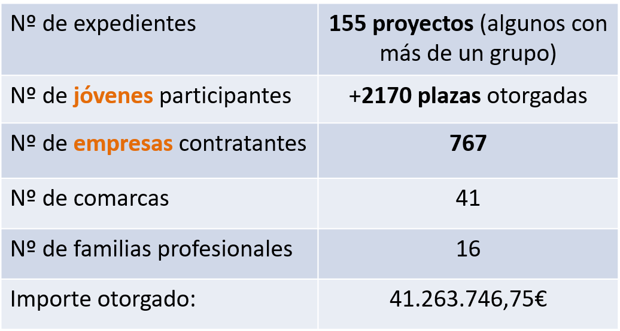
DATA ON IMPACT
DUALVT RESULTS 2021 AND 2022
Notes:
No. of cases
155 projects (some with more than one group)
No. of youth participants
+2,170 spots filled
No. of hiring companies
767
No. of regions
41
No. of professional categories
16
Amount awarded:
€41,263,746,75

Slide 8


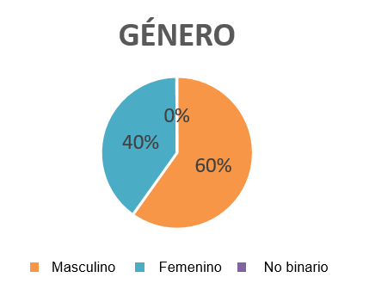
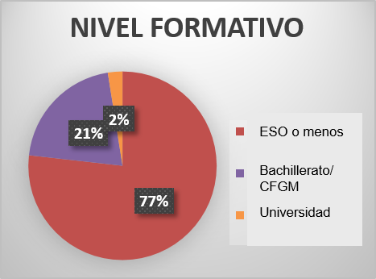
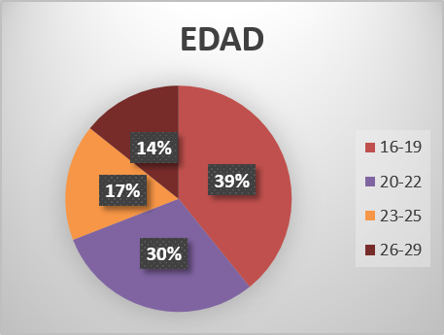
PROFILE OF PARTICIPANTS
PRIMARILY MALE, LESS THAN 23 YEARS OLD, NO TRAINING AFTER MANDATORY SECONDARY EDUCATION
Notes:
GENDER
Male
Female
Non-binary
EDUCATION LEVEL
GCSE or less
A Levels/High school
University
AGE

Slide 9
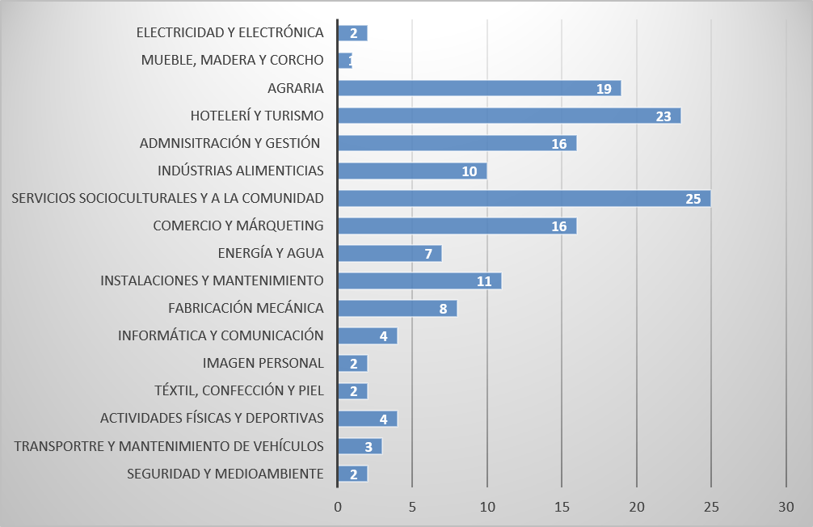

CASES BY PROFESSIONAL CATEGORY
Notes:
ELECTRICITY AND ELECTRONICS
FURNITURE MAKING, CARPENTRY AND CORK
AGRICULTURE
HOSPITALITY AND TOURISM
ADMINISTRATION AND MANAGEMENT
FOOD INDUSTRY
SOCIOCULTURAL AND COMMUNITY SERVICES
SALES AND MARKETING
ENERGY AND WATER
FACILITIES AND MAINTENANCE
MECHANICAL MANUFACTURING
IT AND COMMUNICATIONS
PERSONAL IMAGE CONSULTING
TEXTILES, APPAREL AND LEATHER
PHYSICAL ACTIVITIES AND SPORTS
TRANSPORTATION AND VEHICLE MAINTENANCE
SAFETY AND THE ENVIRONMENT

Slide 10






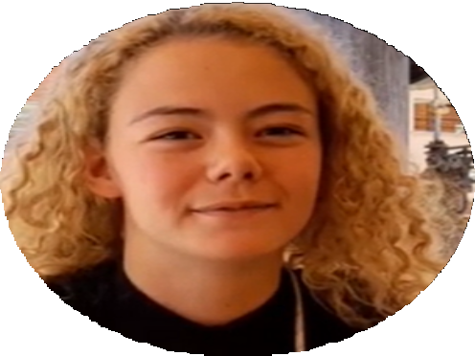







TESTIMONIALS
María
I could study an Administrative Assistant DualVT because you don't need to have money to do it.
Ángel
I studied a Renewable Energy DualVT because there's a future there and I want to become who I want to be.

Slide 11



THANK YOU!
DEPUTY DIRECTOR FOR YOUTH EMPLOYMENT AND PROFESSIONAL QUALIFICATION

